Slide 1

SAP Analytics cloud training
Anubhav Oberoy
Day 5

Slide 2
Agenda – Day 5
Introduction to Planning
- What is Planning
- Evolution of Planning
- Collaborative Planning
- SAC Supports Planning options
- Planning Jargons
- Introduction to Planning models
---Break---
Working with Planning Models
- Create Demo Scenario
- Create Planning Model
- Version Management
- Create Simple Balance Sheet
- What if Analysis
- Update Scenario

Slide 3


What is planning
Planning is a fundamental management function, which involves deciding before head,
what to be done,
when it will be done,
how it will be done and
who is going to do it.
It is an intellectual process which lays down an organization objectives to be able to achieve those goals. It chalks out specifically how to attain a specific goal. For example: how many new resources I need to hire in the same's department to touch 1bn sales.
Planning is performed for various functions of a company, such as sales planning, expense planning, core financial planning, reporting FY numbers through reports to shareholders of the company. HR plans for the people at all suggested levels (VP, SVP, Managers). Planning helps to increase coordination and onerous tasks that are distributed across multiple departments.
www.anubhavtrainings.com

Slide 4
Planning Evolution with SAC
PAST
NOW
NEXT
Centralized process to connect strategy to financial goals
SAP (BPC) dominated the “Corporate Core”
Decentralized owned by the business
business buyer take over buying decision
Connect all LOBs across the enterprise
SAC embedded in Enterprise Intelligent Suite
www.anubhavtrainings.com

Slide 5
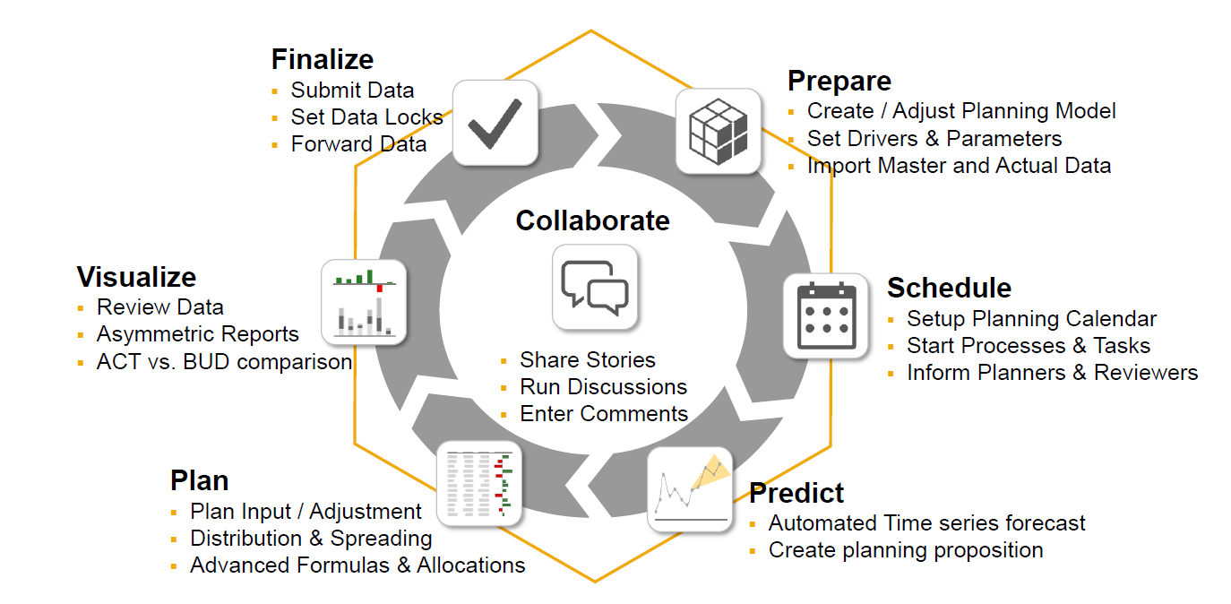
What is collaborative planning
www.anubhavtrainings.com

Slide 6
What are all we do in SAC
Modeling
What-if and Visualization
Allocation
Predictive Forecast
Value Driver Trees
Collaboration
Collect data
Model Dimensions
Currency conversion rates
Create planning model
Set the rates
Define account dimension (business account)
Version management
Direct Entry
Distribution/spreading
Variance chart
Copy/paste data
Introduce new entity
Thresholds
Asymmetric reports
Formulas
Forecast
www.anubhavtrainings.com

Slide 7
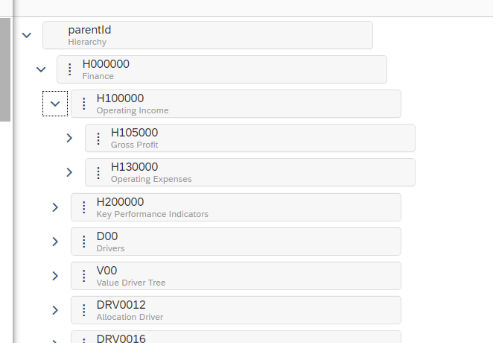
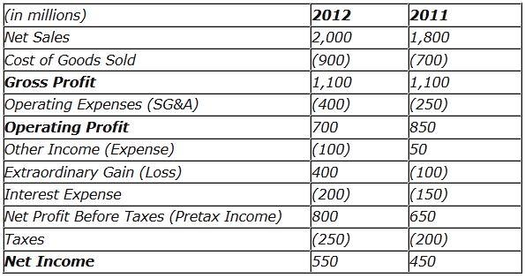
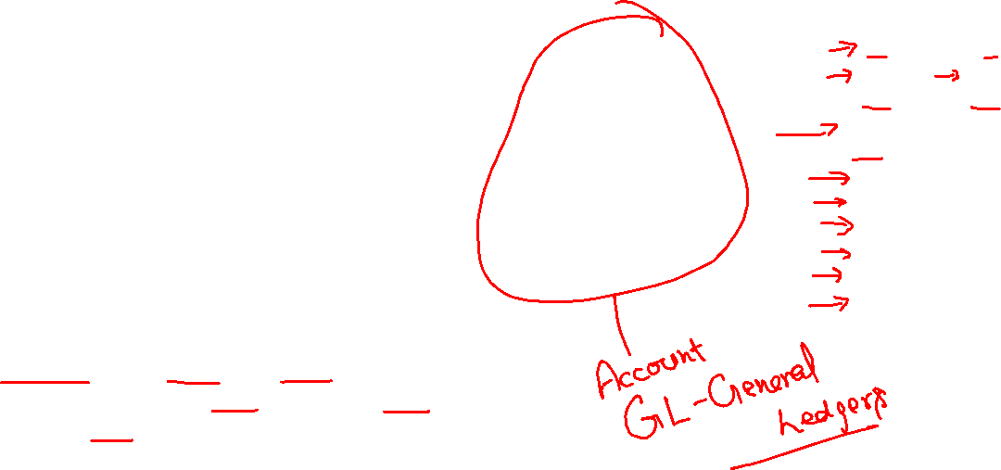
Planning Jargons
Revenue: Total amount of goods and services produced by an organization in a given span of time.
GDP – (Country)
Gross Revenue: total income earned by a co. in a specific period.
1000 X 100$ = 100,000$ - 5000$ = 95000$
Indicate the potential for the growth.
Revenue = Units X Price per unit
Net Revenue = Revenue – Returns – Discounts
Net revenue is indicative of quality
Gross Profit = Net Revenue – Cost of goods(raw, labor, machinery, packaging, shipping)
Gross Margin % = Gross Profit / Net revenue
Operating Profit % = Operating income / Net Revenue
Operating Expense Ratio (OER) = Operating Expense/ Net Revenue
www.anubhavtrainings.com

Slide 8
Planning Model – need to know
Planning data model includes versions (categories – Actuals, Forecast, Budget)
Actuals: Current facts data which is most recent or could be past experiences in reality. Transaction data.
Budget: Budgeting is the financial direction of where management wants min to be achieved, this is what will help qualifying the expectations of revenue that business expects. The budgeting number decides the bottom line of the company.
Forecast: tells whether the company is headed in right direction, estimating the amount of revenue and income that be achieved in future.
2. Planning models, will mandatorily have DATE/TIME Dimensions
3. We can also have organization dimension which represents the Business Entity (a plant, a subsidiary).
Regions → Country → States → Cities → Entity
www.anubhavtrainings.com

Slide 9



Slide 10




















Slide 11
Planning model – Account Dimension
4. Account Dimension
In a planning model represents a business ledger account like operating expense, gross profit, net revenue. Most of these are calculated by other dimensions.
We will always can have a parent-child hierarchy in a/c dimension. This hierarchy is used to aggregate the numbers and calculate accounts based on hierarchy levels.
For each account dimensions we have contributions
EXP, INT – Expense – negative
INTINC, INC – Income -- positive
NFIN – Non Financials
5. We can apply currency conversion in finance data dependent on exchange rates
Average, Closing
www.anubhavtrainings.com

Slide 12
Create Planning Model – Hands on
Planning Model demo dataset <link>
1. Mark Properties and descriptions (later used for hierarchy creation)
2. Geo Enrich Data
3. Mark ENTITY, ACCOUNT, DATE and VERSION Dimensions
4. Data Wrangling
----Model created
1. Maintain model preference for FY, Data, Currency Conversion
----Model Hierarchies
1. Copy paste the account data properly
2. Create a story on planning model
www.anubhavtrainings.com

Slide 13
Demo Scenario
- Stefany Myer
<Click here>

Slide 14
Version Management
While working with finance/planning data, we don’t want to change the actual facts because we just want to play around with data and see if this data can be used for productive purpose later. As an SAC consultant, until you finalize all the changes, you want to work privately by changing data number of times.
So we always have possibility to create multiple versions of the data by copying existing version data.
SAC options → Version Management
And we will create a new version. This will be private (which means, other users in SAC tenant will not be able to see it, until we publish)
What If Analysis
Where the business will ask, what if questions e.g. what is the impact of change of one account on another. Like if we like to increase operating income by 10%, what will be the impact of the same on operating margin, expenses.
Direct Increase & Decrease | Variance Chart | Distribution & Spreading
www.anubhavtrainings.com

Slide 15
Planning continues…
Updates
When a particular a/c or Dimension data is not available in SAC, we want to introduce the same, we can also use the planning using updates scenario.
e.g. my co. wants to introduce a subsidiary in another country in a region, how much profit can I increase if I do so.
HANA Function Documentation
http://sap.optimieren.de/hana/hana/html/_gsql_functions.html
www.anubhavtrainings.com

Slide 16
End of Day 5

Slide 17

Questions

Slide 18

Anurag Bajaj
anurag.bajaj02@gmail.com

